Slide 1
Chapter 6
Memory Management
1

Slide 2
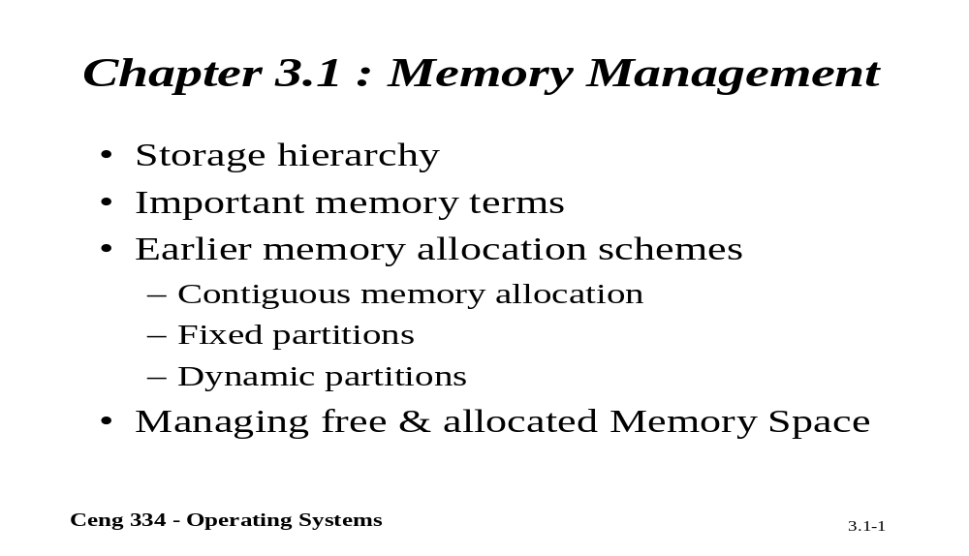
Chapter 3.1: Memory Management

Slide 3
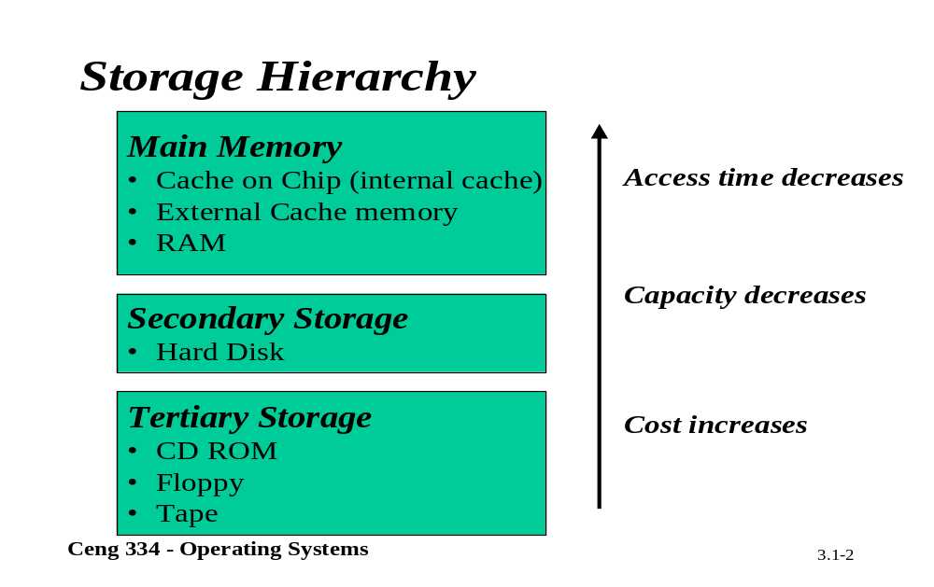
Storage Hierrachy

Slide 4
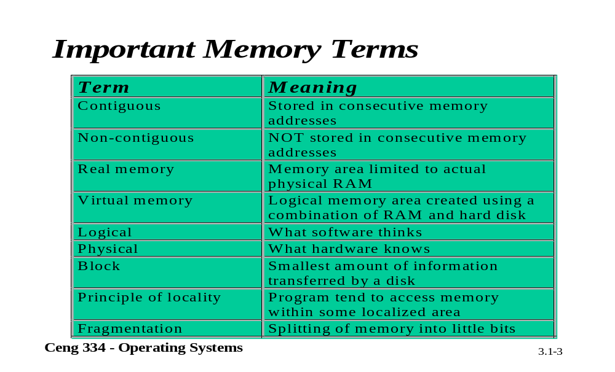
Important Memory Terms

Slide 5
Memory Management
Ideally programmers want memory that is
  large
  fast
  non volatile
Memory hierarchy
  small amount of fast, expensive memory – cache
  some medium-speed, medium price main memory
  gigabytes of slow, cheap disk storage
Memory manager handles the memory hierarchy

Slide 6

Basic Memory Management
Monoprogramming without Swapping or Paging
Three simple ways of organizing memory
- an operating system with one user process

Slide 7
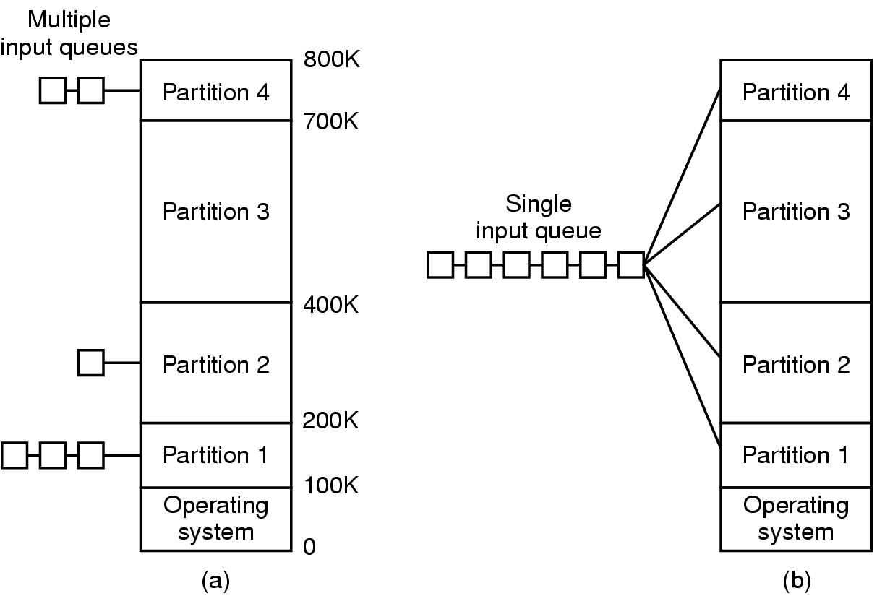
Multiprogramming with Fixed Partitions
Fixed memory partitions
  Her bölüm için ayrı giriş sıraları
  Tek giriş sırası

Slide 8
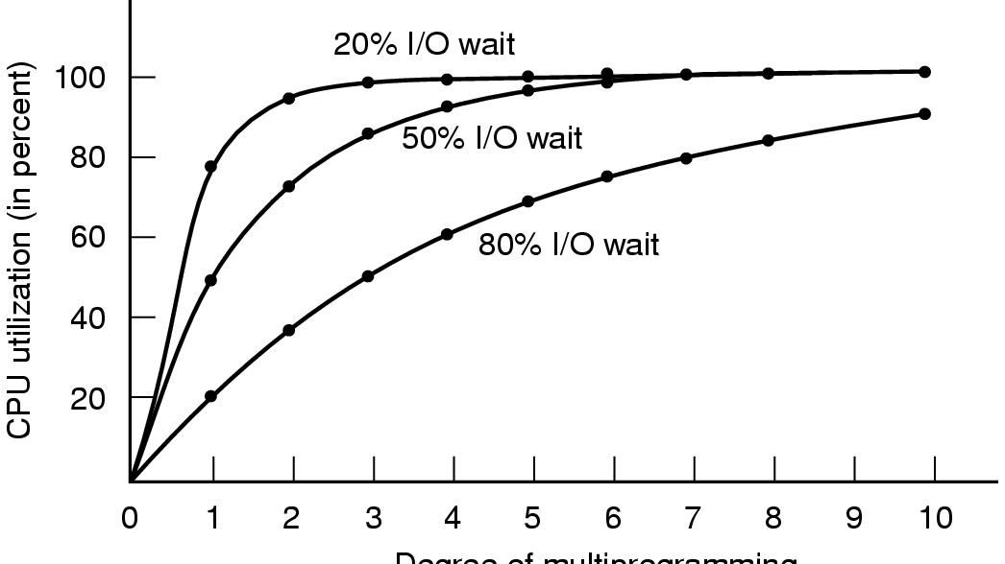
Modeling Multiprogramming
Degree of multiprogramming
CPU utilization as a function of number of processes in memory

Slide 9
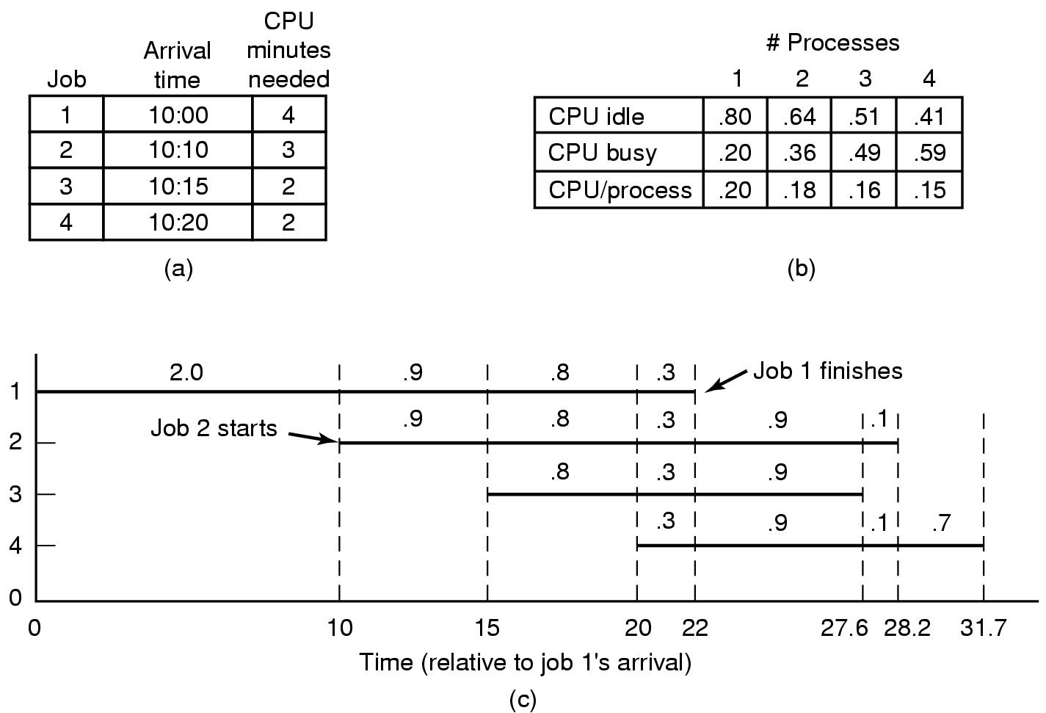
Analysis of Multiprogramming System Performance
Arrival and work requirements of 4 jobs
CPU utilization for 1 – 4 jobs with 80% I/O wait
Sequence of events as jobs arrive and finish
  note numbers show amout of CPU time jobs get in each interval

Slide 10
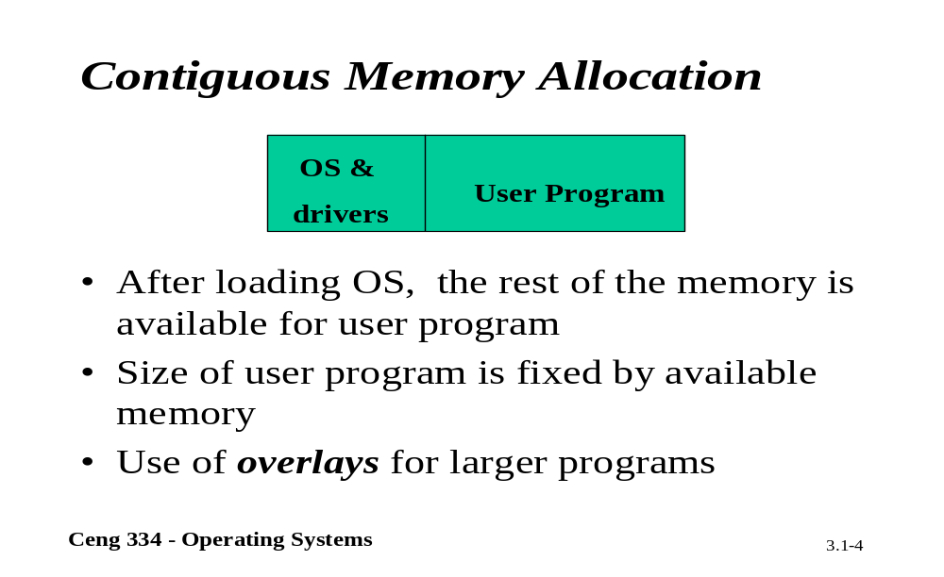
Contiguous Memory Allocation

Slide 11
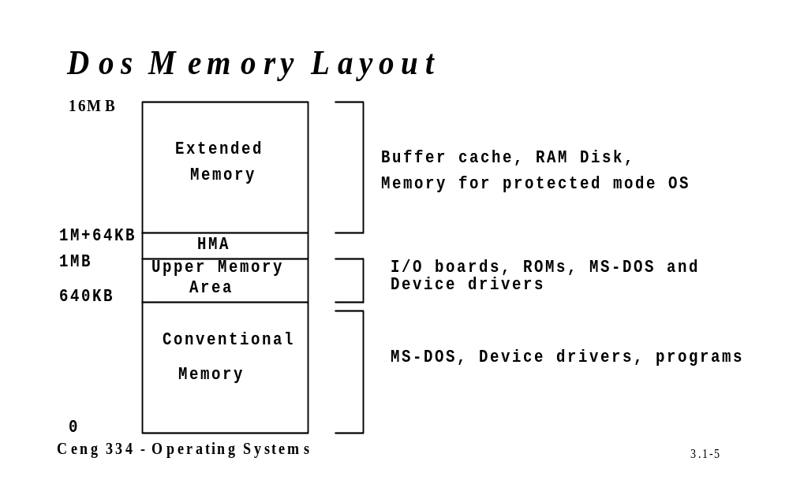
Dos Memory; Memory Map

Slide 12
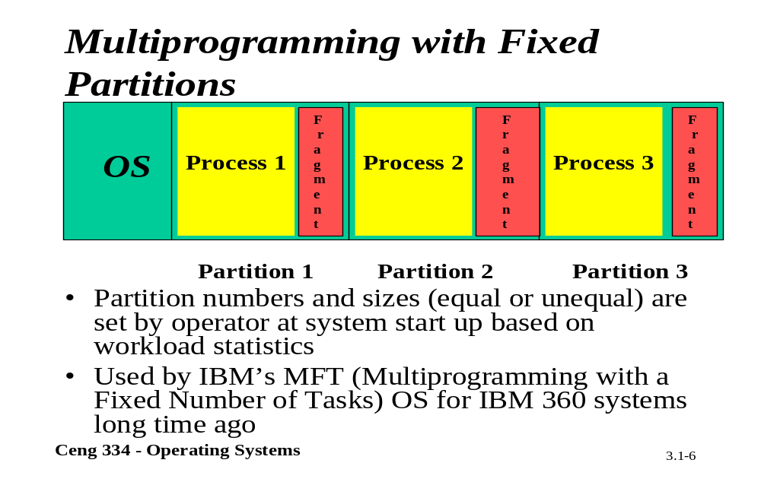
Fixed Partitions

Slide 13
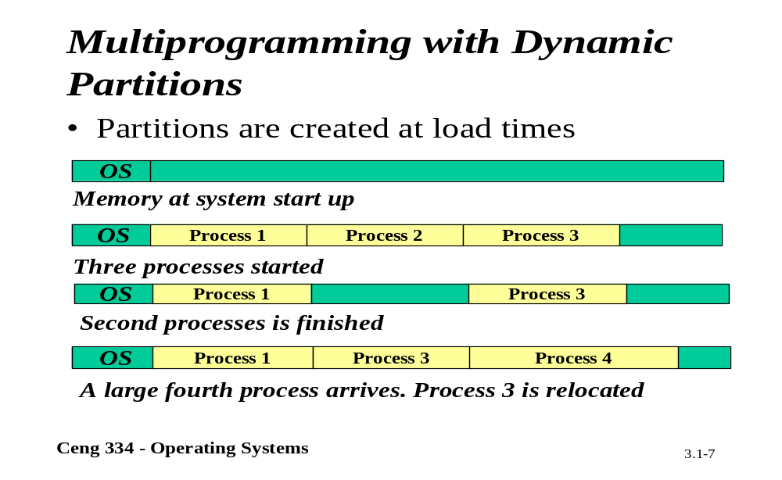
Dynamic Partitions

Slide 14
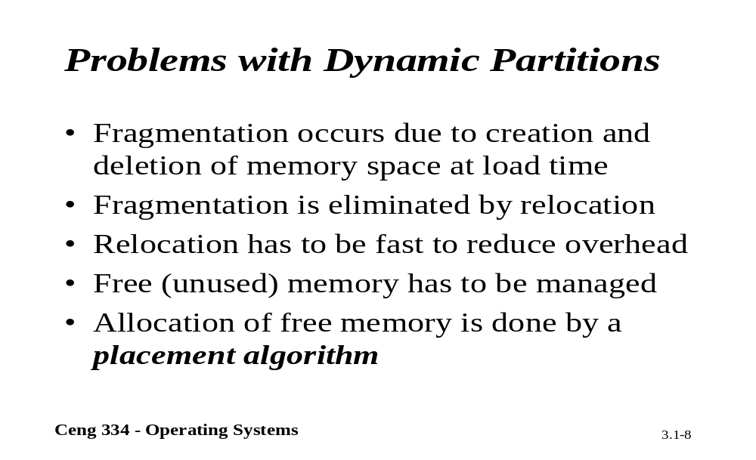
Problems

Slide 15

Swapping (1)
Memory allocation changes as
  processes come into memory
  leave memory
Shaded regions are unused memory

Slide 16

Swapping (2)
Allocating space for growing data segment
Allocating space for growing stack & data segment

Slide 17
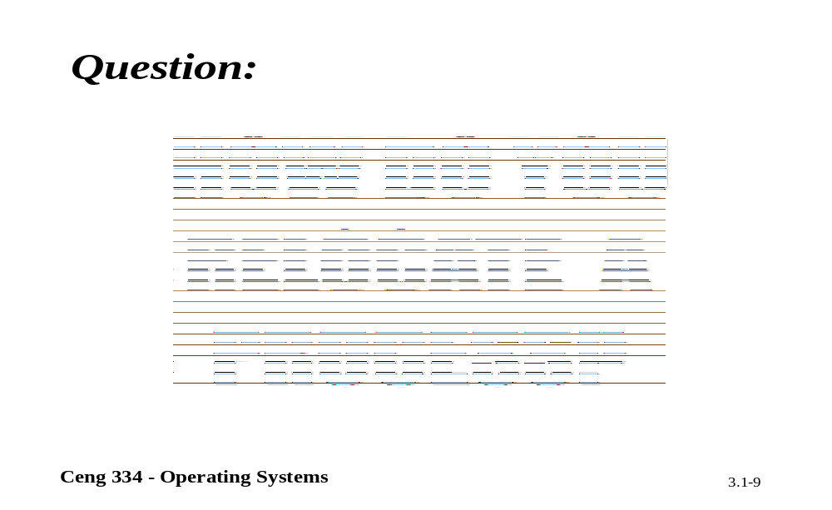
Relocate

Slide 18
Relocation and Protection
Cannot be sure where program will be loaded in memory
  address locations of variables, code routines cannot be absolute
  must keep a program out of other processes’ partitions
Use base and limit values
  address locations added to base value to map to physical addr
  address locations larger than limit value is an error

Slide 19
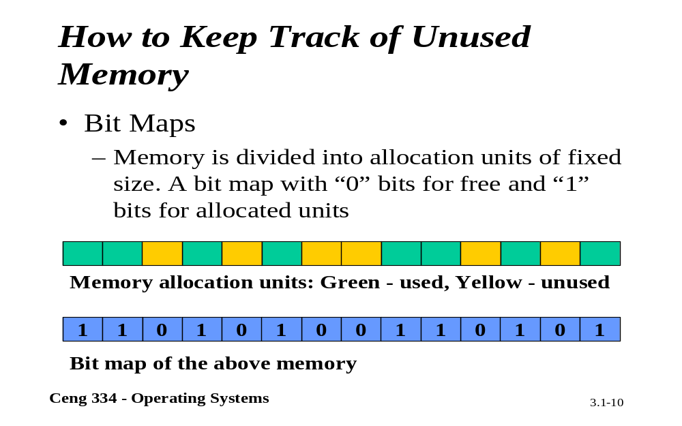
Unused Memory

Slide 20
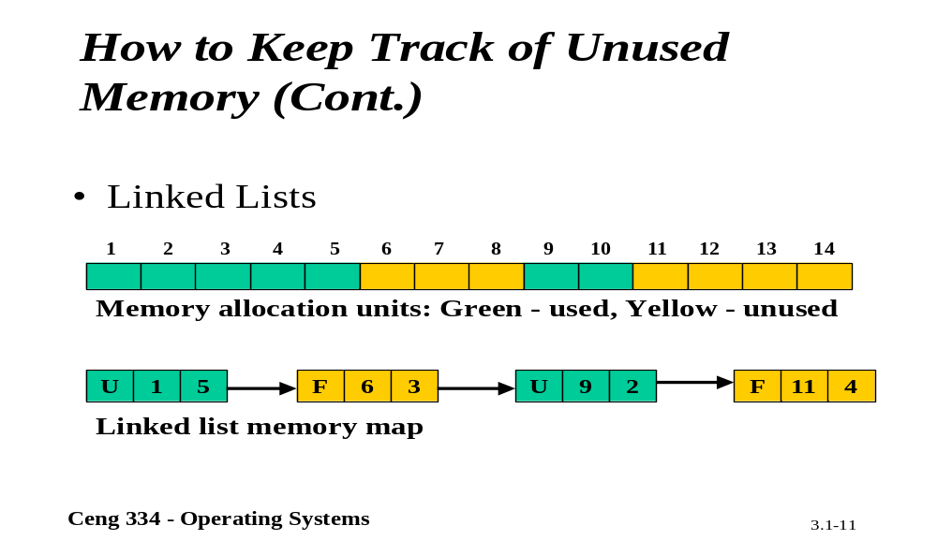
Unused Memory

Slide 21
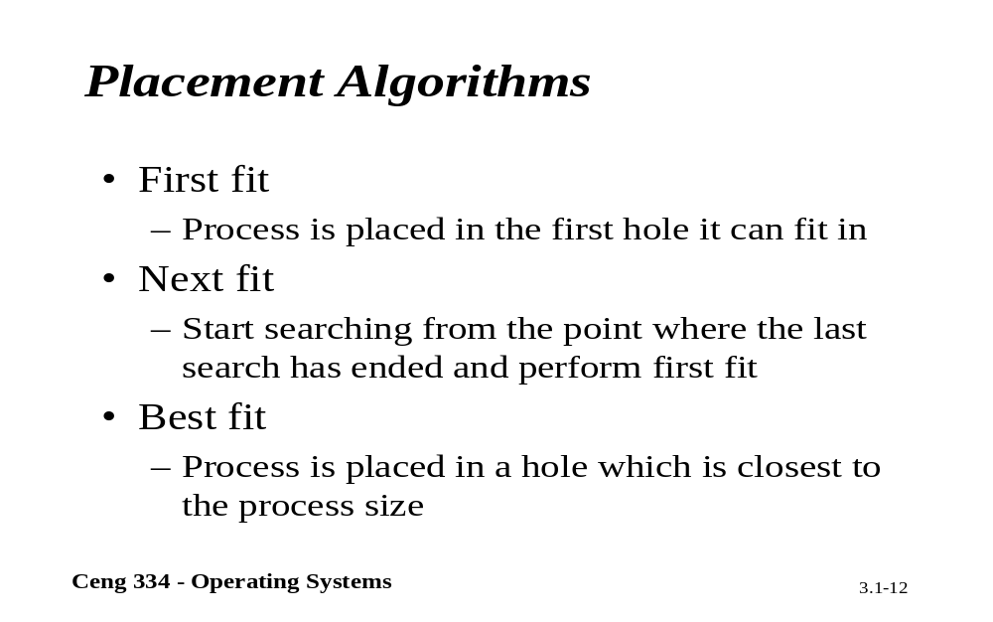
Placement Algorithms

Slide 22
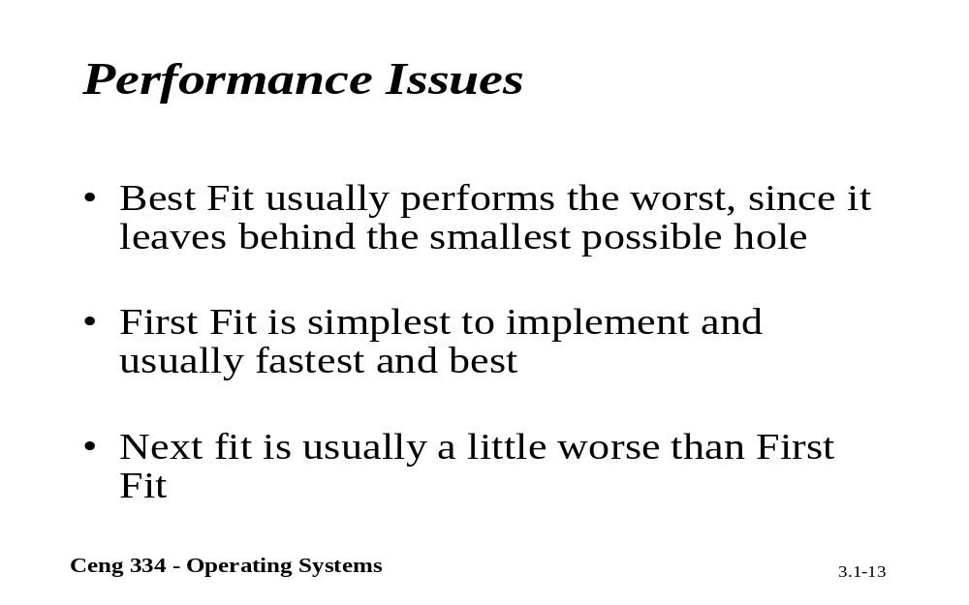
Performance Issues

Slide 23
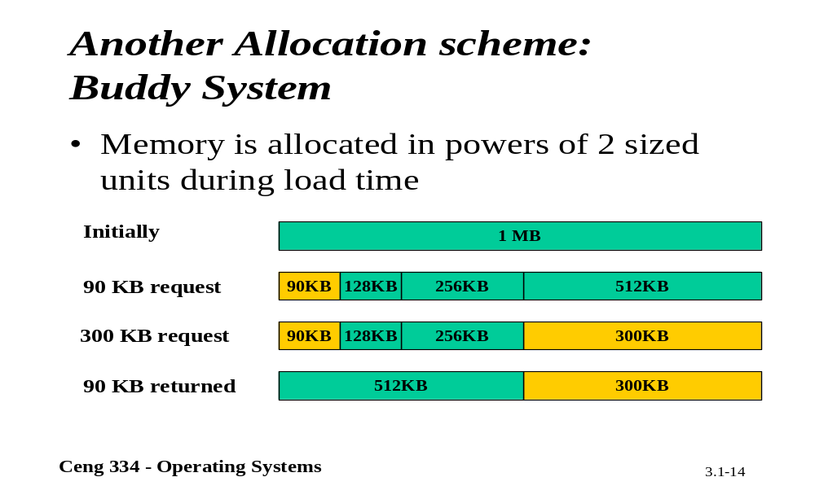
Buddy Ssytem

Slide 24
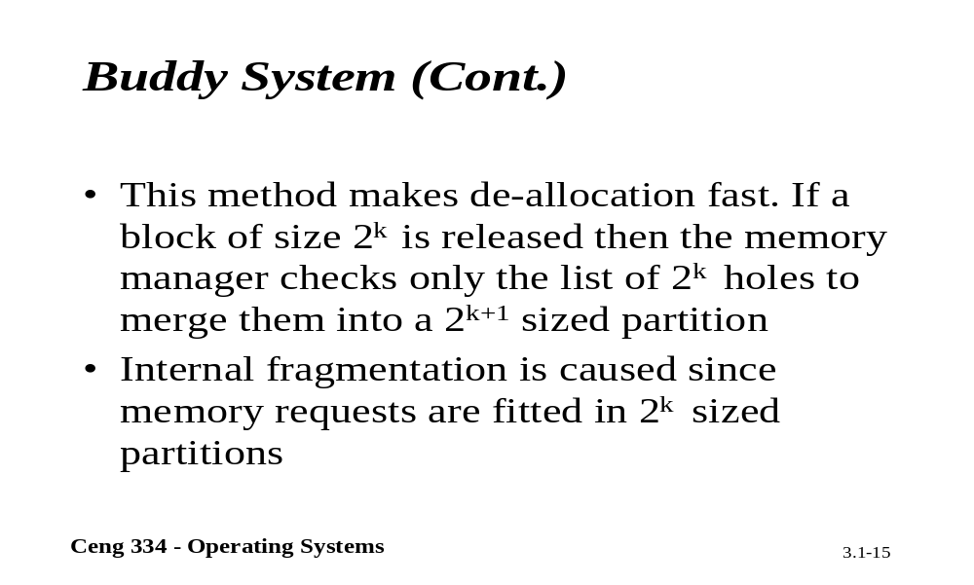
Buddy System

Slide 25
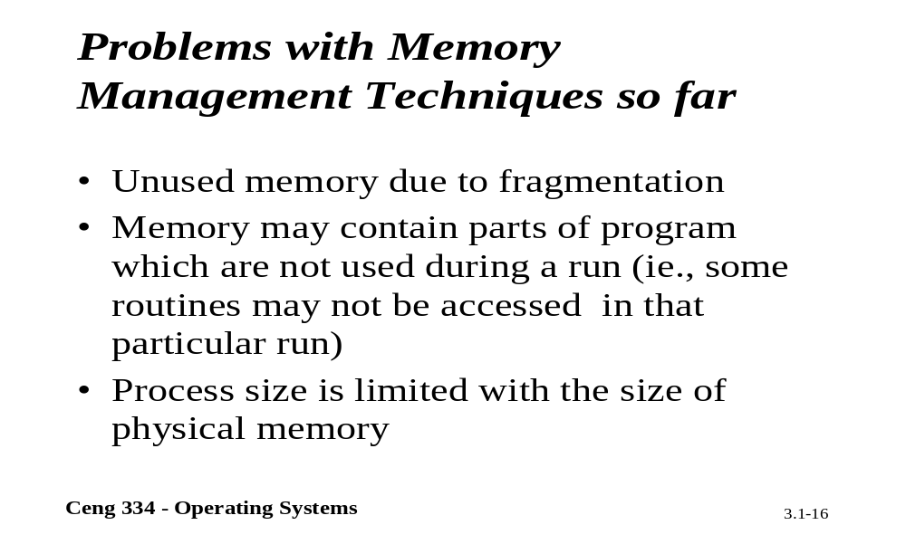
Problems with Memory Mang.

Slide 26

Memory Management with Bit Maps
Part of memory with 5 processes, 3 holes
  tick marks show allocation units
  shaded regions are free
Corresponding bit map
Same information as a list

Slide 27
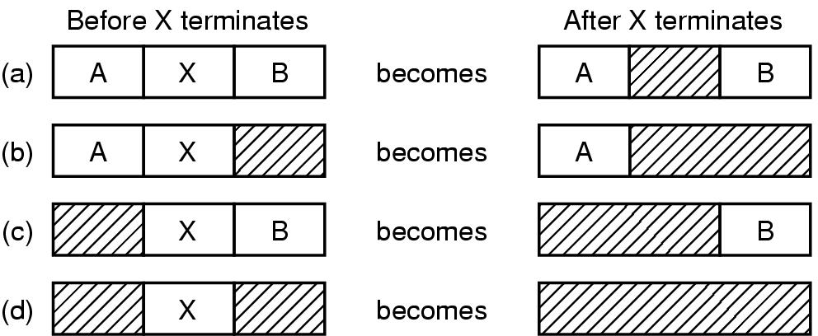
Memory Management with Linked Lists
Four neighbor combinations for the terminating process X

Slide 28
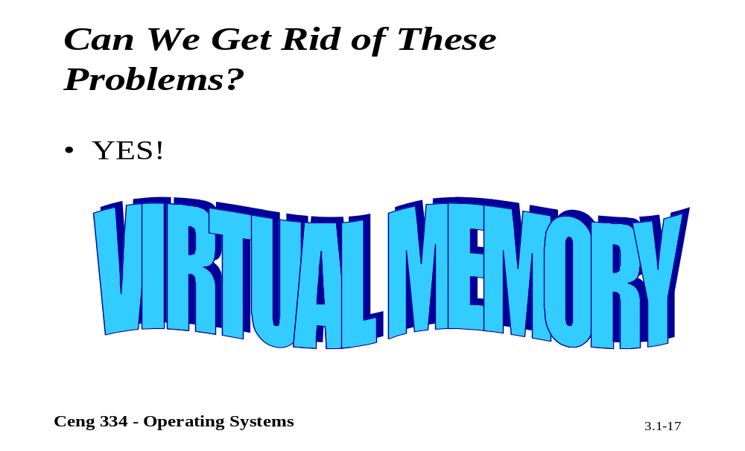
Virtual Memory

